Slide 1

Cold Storage Management System
Presented By:
M. Sai Kumar(18471A0530)
N. Rajesh(18471A0535)
K. S. V. S. Chandra Prasad
(18471A0521)
GUIDANCE BY
Dr. S. N. Tirumala Rao, M.Tech, Ph.D
Professor
Notes:
NOTE:
To change the image on this slide, select the picture and delete it. Then click the Pictures icon in the placeholder to insert your own image.

Slide 2
ABSTRACT:
India is one of the largest producers of agricultural products having diverse agro-climate zones across the country with vast range of agricultural products.
The reprehensible storage results in high losses in grains, 30% of fruits and vegetables grown. During storage, quantitative as well as qualitative losses occur due to insects, rodents, and micro- organisms.
To address the issues of the above concern and maintain proper stock details off all type of qualitative and qualitative loss products including their costs, we propose Cold Storage Management System (CSMS) for cold storage.
Hence the product availability in cold storage with all necessary details of product are available by this mini project

Slide 3
EXISTING SYSTEM:
The Cold Store Management System is designed to be used where:- It is necessary to control stock both by pallet (or carton or container) and by stock type where the stock location needs to be controlled by the system.
It is important to be able to control stock by receipt date / date of manufacture / the sell by date.
This means that the oldest useable stock will always be issued first irrespective of its location in the Cold Store.
Stock is stored on behalf of third parties i.e. commercial Cold Stores.
This is all done with maintaining records manually in a log book or in a micro soft excel to generate bills and maintain the stock details

Slide 4
PROPOSED SYSTEM:
PROPOSED SYSTEM:
PROPOSED SYSTEM:
All software projects start by identifying a clear objective or goal .
Major objective of this report is to analysis Design and Implementation of Cold storage Management System .
Looking at the problems posed by the existing system of Cold storage, the objective can be sum up as follows to develop a Cold storage Management System for efficiently and effectively store all information related to different payments, loan, operational advance etc.
Allow the Management to easily access that information as necessary.
Less Documentation and Faster working performance and thus saving times.
In a form the information is desired by the Management, in a quick and effective order so that decisions can be made for proper and optimal business operations.

Slide 5
HARDWARE AND SOFTWARE REQUIREMENTS
HARDWARE REQUIREMENTS
Processor : Intel® Dual Core 2.0GHz minimum
Hard Disk : 20GB or more
RAM : 1 GB or More
SOFTWARE REQUIREMENTS
Operating System : Windows 2012 Server or later
Language : .NET Framework 4.5 or later
Database server : SQL server 2012 or later
Web Server : IIS 8.0
Browser : Any latest browser like Google Chrome

Slide 6
Modules
Admin Module
Customer Module

Slide 7
Admin Module:
Adds Customers
Adds Inward Products
Adds Outward Products
Adds Payment Information
Adds Customer Loan Information
Creates Invoice for Outward Products

Slide 8
Customer Module:
Can login into the application
Can view his/her profile
Can download Invoice

Slide 9
      Database Tables

Slide 10
Customer Details table:
S.No | Field | Type | Constraint | Description
1. | Customer D | varchar(50) | IDENTITY(1,1) | Customer ID
2. | Customer ID | varchar(50) | Not Null | Customer ID
3. | Customer Phone Number | Number(10) | CHECK( Length=10) | Customer Phone Number
4. | Customer Email | varchar(50) | Not Null | Customer Email ID
5. | Customer House Number | varchar(50) | Not Null | Customer House Number
6. | Customer Street ID | varchar(50) | Not Null | Customer Street ID
7. | Customer City | varchar(50) | Not Null | Customer City
8. | Customer Zip Code | Number(10) | Not Null | Customer Zip Code
9. | Customer State | varchar(50) | Not Null | Customer State

Slide 11
Admin Login Details table:
S.No | Field | Type | Constraint | Description
1. | Admin ID | varchar(50) | Primary Key | Login ID for Admin
2. | Admin password | varchar(50) | Not Null | Password for Login

Slide 12
Customer Login Details table:
S.No | Field | Type | Constraint | Description
1. | Login ID | int | Primary Key | Login ID for Customer Login
2. | Login password | varchar(50) | Not Null | Password for Customer Login

Slide 13
Inward Products Details table:
S.No | Field | Type | Constraint | Description
1. | Inward Product ID | IDENTITY(1,1) | Primary Key | Incoming Product ID
2. | Inward Product _Date | date | Not Null | Incoming Product Date
3. | Inward Product ID | varchar(50) | Not Null | Incoming Product ID
4. | Inward Product Cost | money | Not Null | Incoming Product Cost
5. | Inward Product Quantity | int | Not Null | Incoming Product Quantity
6. | Inward Product Location | varchar(50) | Not Null | Incoming Product location
7. | Customer ID | int | Foreign Key | Customer ID
8. | Inward Product Insurance | boolean | Not Null | Incoming Product Insurance
9. | Inward Product Rent | Number(10) | Not Null | Incoming Product Rent

Slide 14
Outward Products Details table:
S.No | Field | Type | Constraint | Description
1. | Out_Prod_ID | int | Primary Key | Outgoing Product ID
2. | Out_Prod_Date | Date | Not Null | Outgoing Product Date
3. | Out_Prod_ID | varchar(50) | Not Null | Outgoing Product ID
4. | Out_Prod_Cost | money | Not Null | Outgoing Product Cost
5. | Out_Prod_Quantity | int | Not Null | Outgoing Product Quantity
6. | Out_Prod_Location | varchar(50) | Not Null | Outgoing Product Location
7. | Customer ID | int | Foreign Key | Customer ID

Slide 15
Payment Details table:
S.No | Field | Type | Constraint | Description
1. | Payment ID | varchar(50) | Primary Key | Payment ID
3. | PaymenType | varchar(50) | Not Null | Payment Type
4. | PaymentAmount | money | Not Null | Payment Amount
5. | PaymentDate | Date | Not Null | Payment Date
6. | PaymentTime | Time | Not Null | Payment Time
7. | CustomerID | int | Foreign Key | Customer ID
8. | PaymentAdvance | money | Null | Amount paid in advance
9. | PaymentDue | money | Null | Amount to be paid

Slide 16
Invoice details:
S.No | Field | Type | Constraint | Description
1. | Bill Number | varchar(50) | Primary Key | Invoice ID
2. | Cstomer ID | varchar(50) | Not Null | Customer ID
3. | Outward Product ID | varchar(50) | Foreign Key | Outgoing Product ID
4. | Payment ID | varchar(50) | Foreign Key | Payment ID
5. | Outward Product Quantity | Number(10) | Not Null | Outgoing Product Quantity
8. | Date | Date | Not Null | Invoice Generated Date
9. | Time | Time | Not Null | Invoice Generated Time

Slide 17
Customer Loan details:
S.No | Field | Type | Constraint | Description
1. | Loan Id | int | Primary Key | Customer Loan ID
2. | Loan Date | Date | Not Null | Loan sanctioned date
3. | Inward Product ID | int | Foreign Key | Incoming product ID
5. | Loan Amount | money | Not Null | Loan sanctioned amount
6. | Bank ID | varchar(50) | Not Null | Loan sanctioned Bank ID
7. | Customer Account Number | bigint | Not Null | Customer account number
8. | Bank IFSC Code | varchar(50) | Not Null | Bank IFSC code

Slide 18
Screen Shots

Slide 19
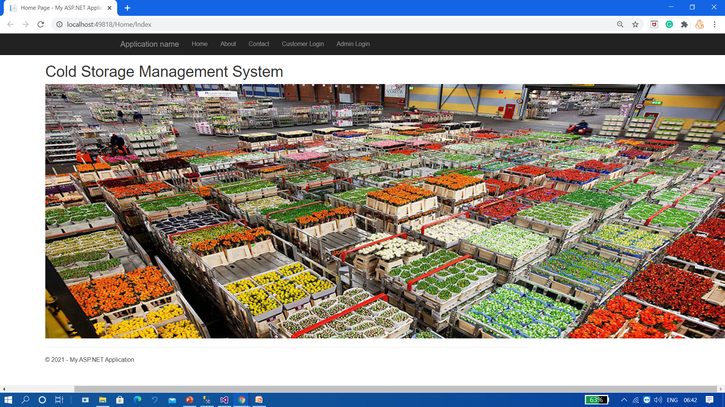
Home Page:

Slide 20
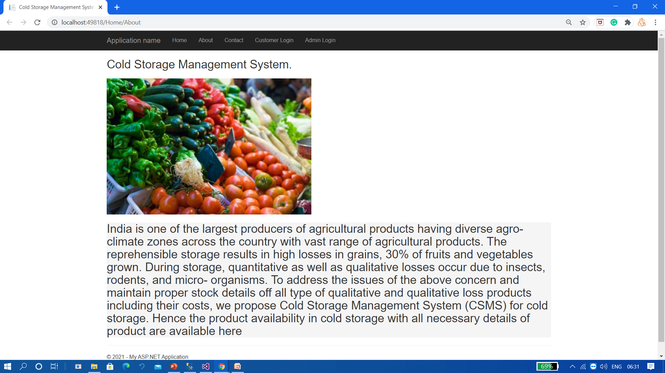
About Page

Slide 21
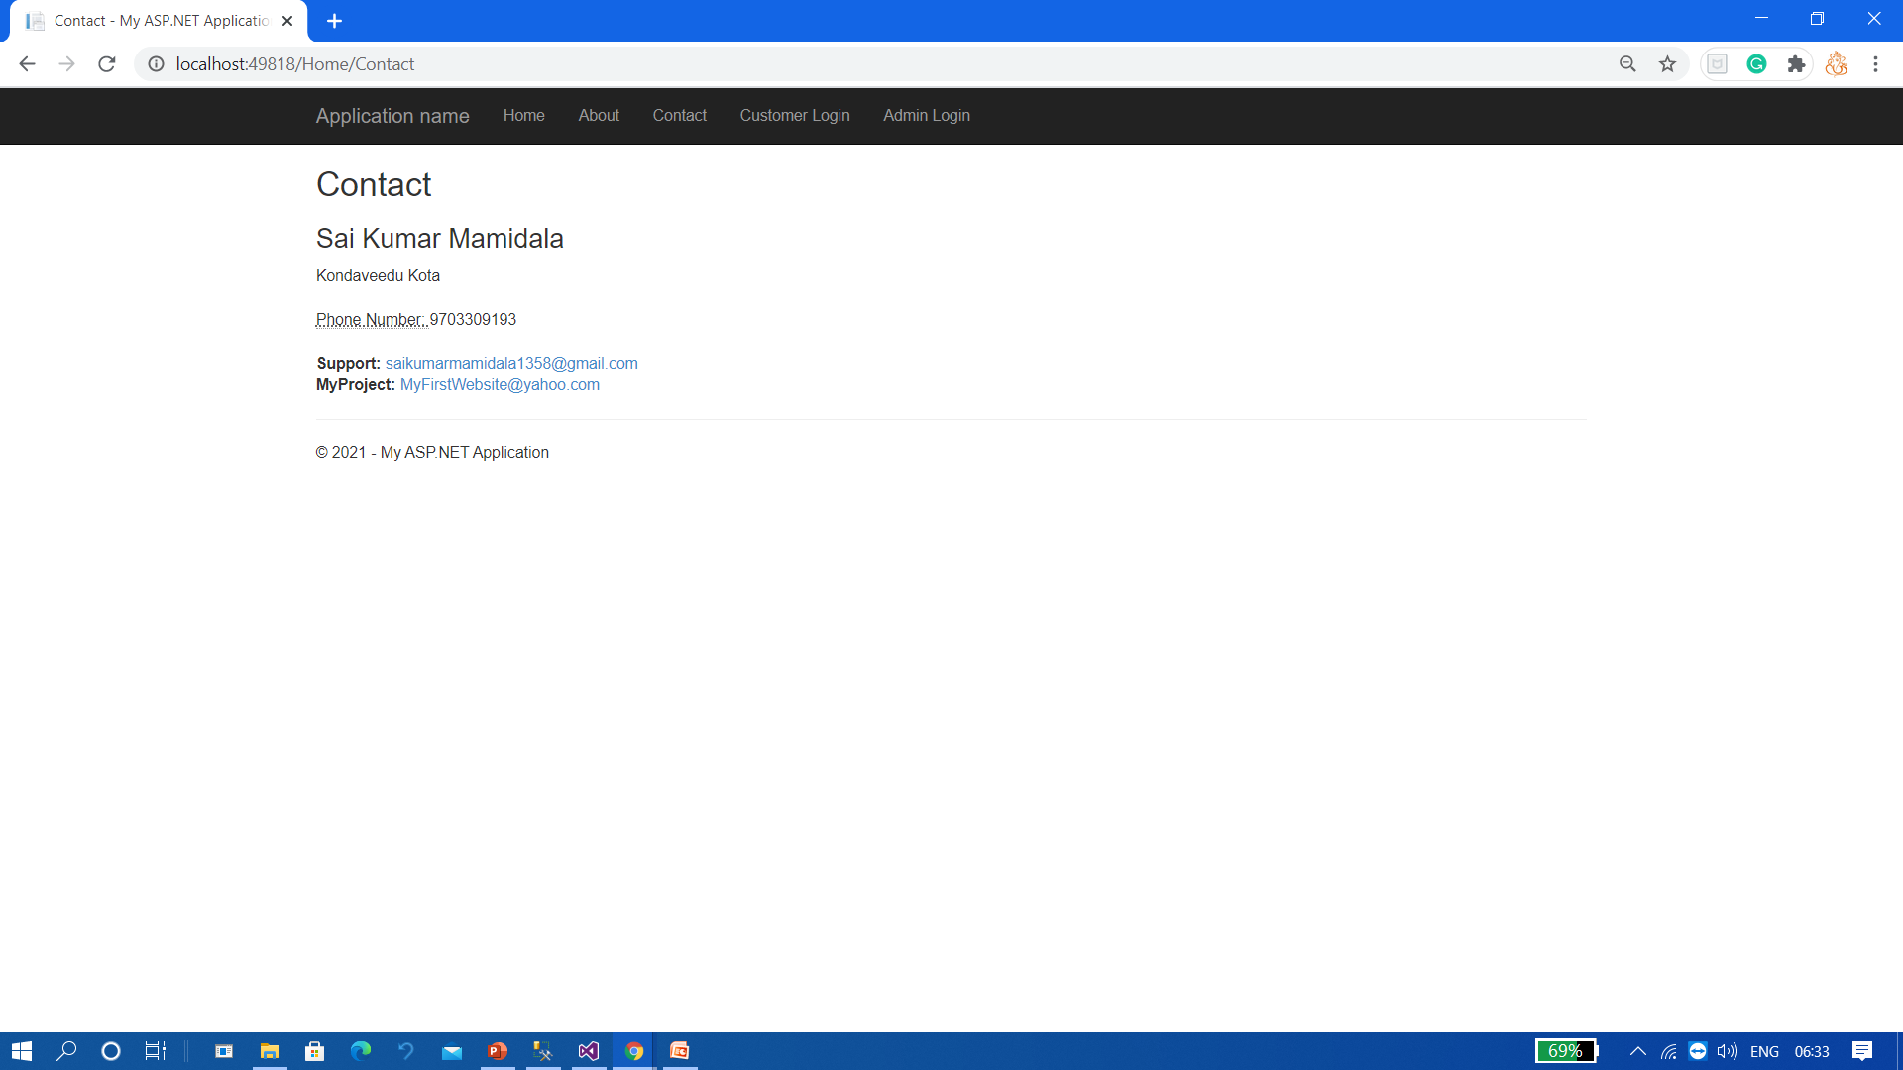
Contact Page:

Slide 22
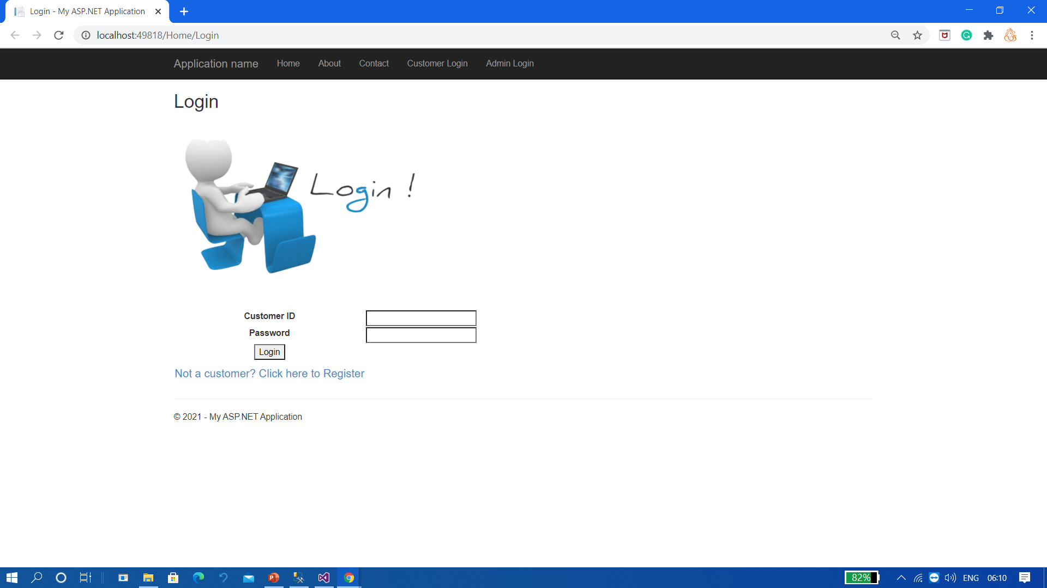
Customer Login:

Slide 23
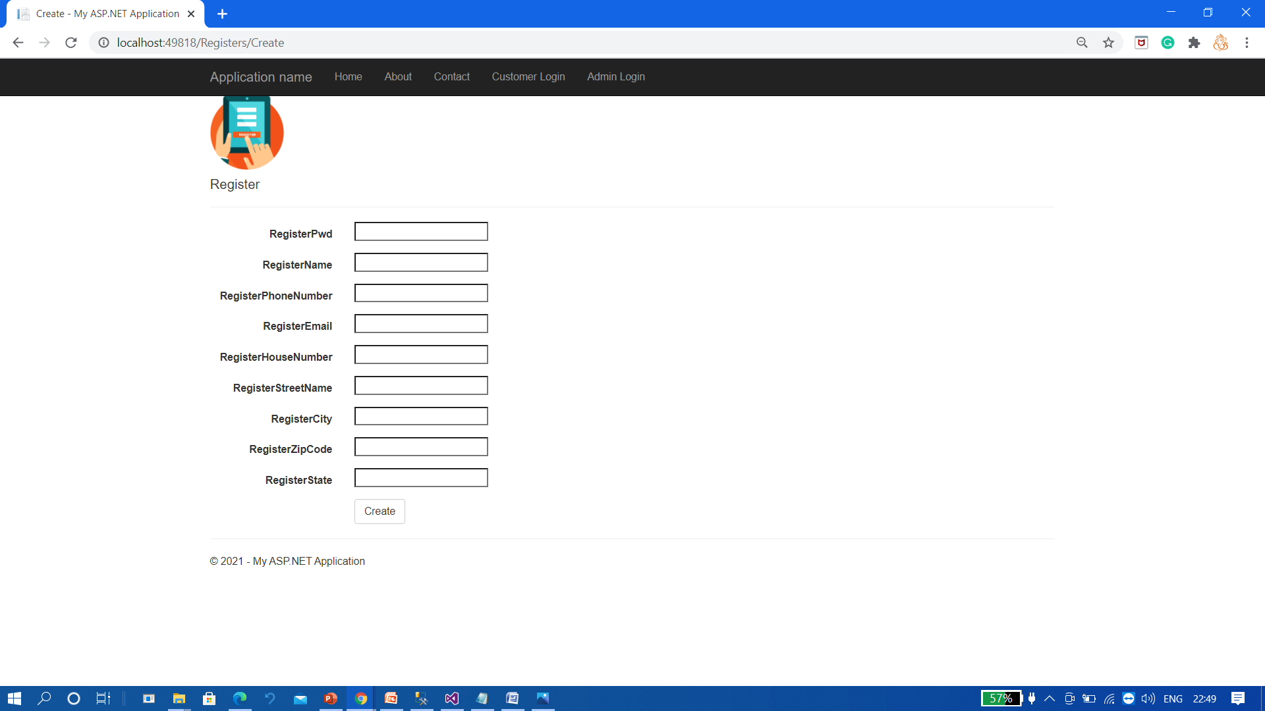
New Customer Registration Form:

Slide 24
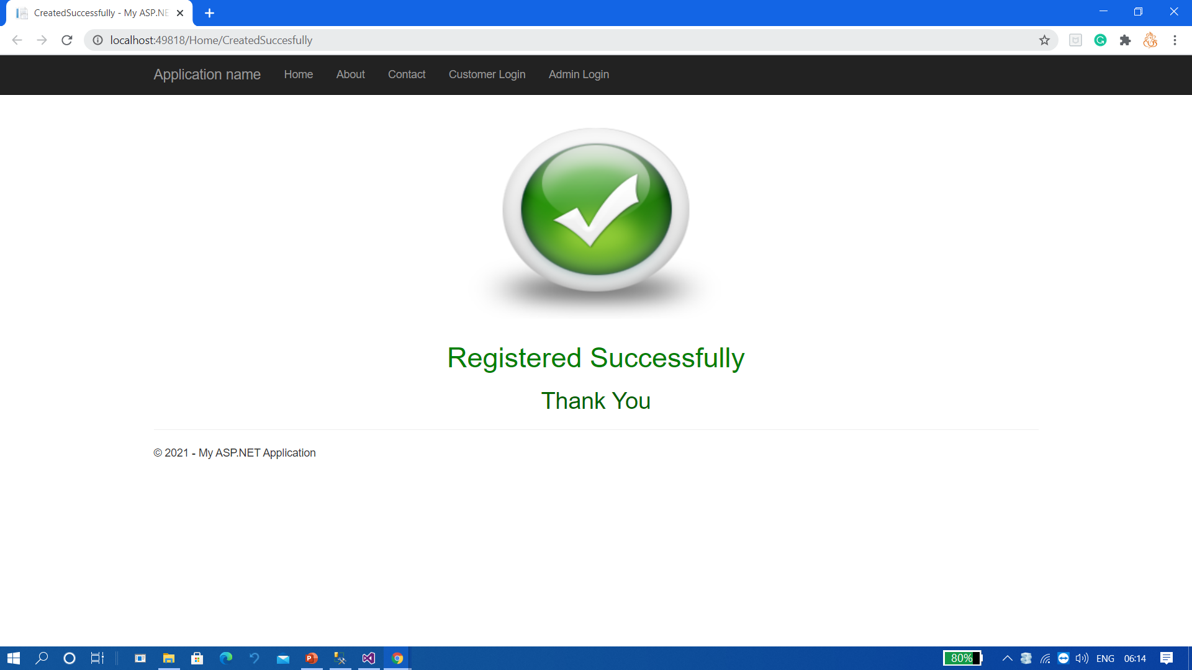
Completion of Customer Registration :

Slide 25
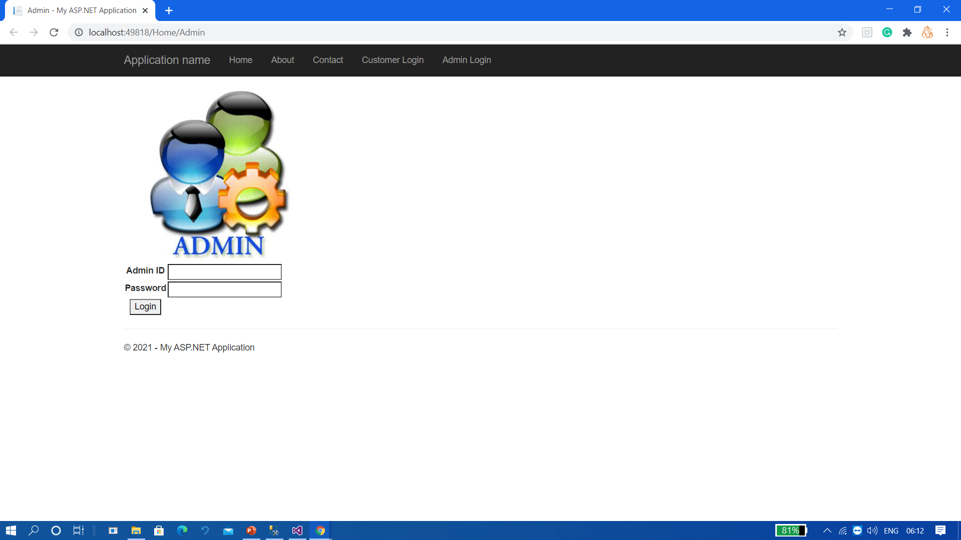
Admin Login:

Slide 26
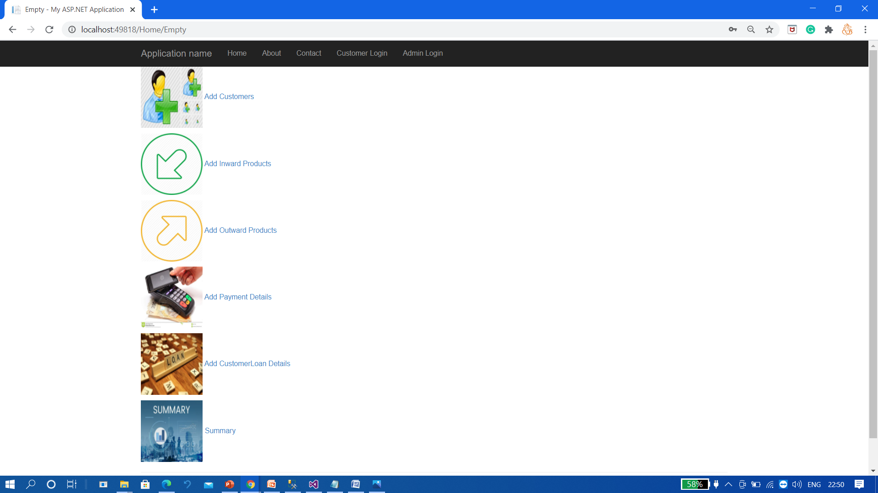
Admin Navigation:

Slide 27
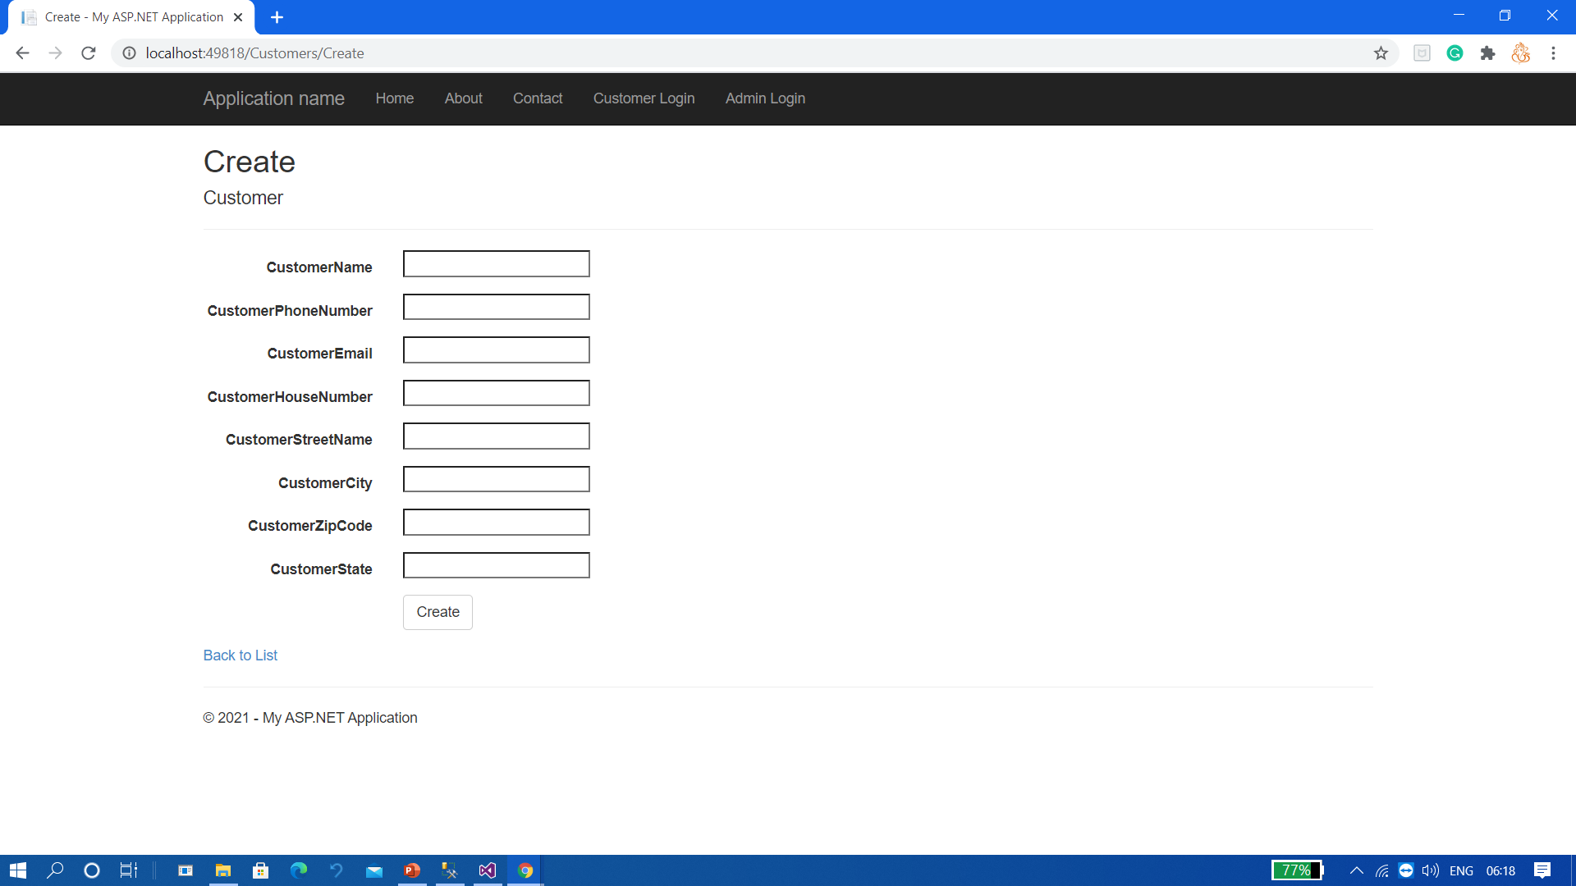
Customers Entry Form:

Slide 28
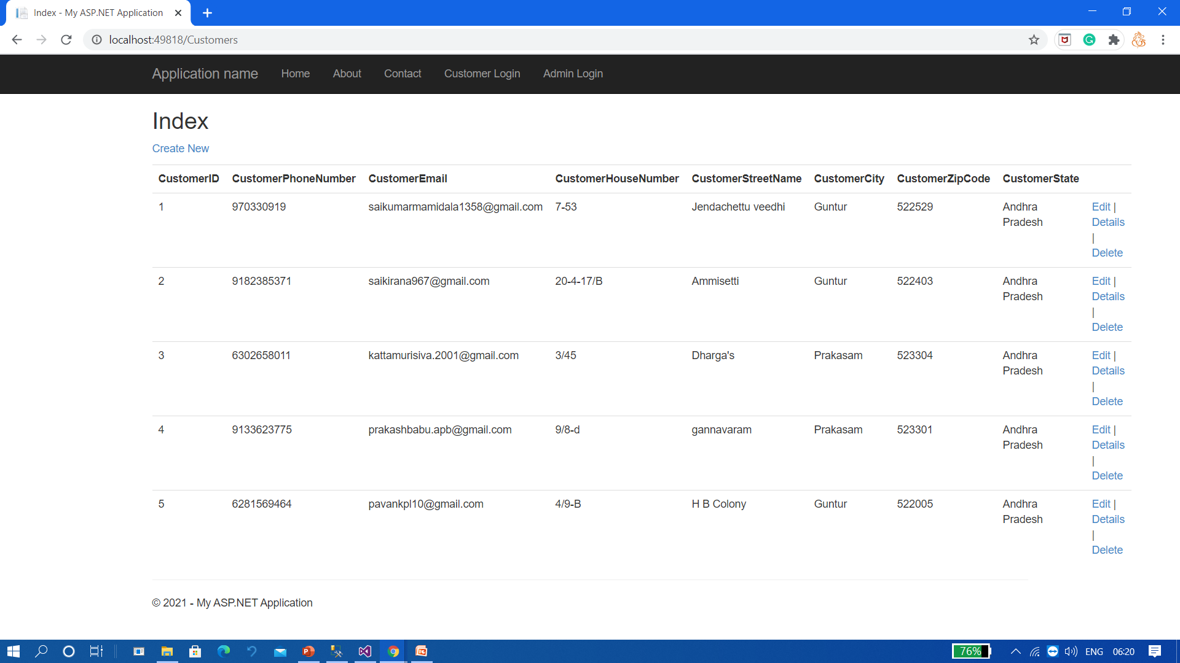
Customer Details

Slide 29
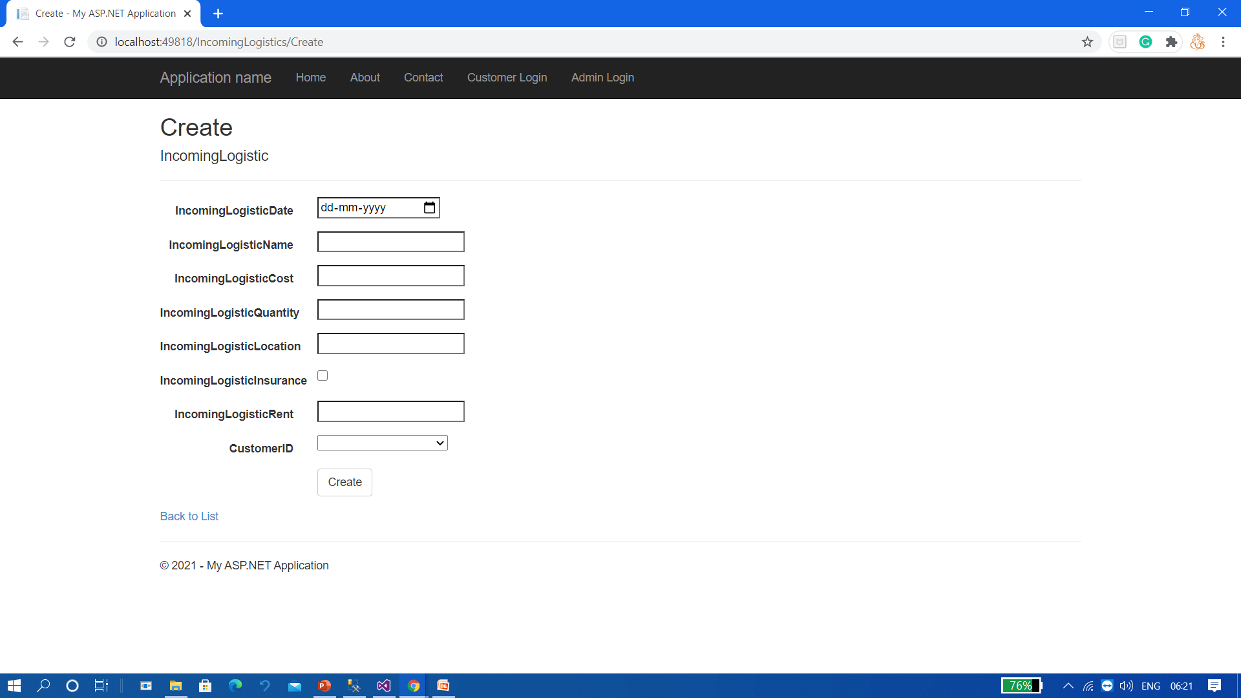
Inward Products Entry Form:

Slide 30
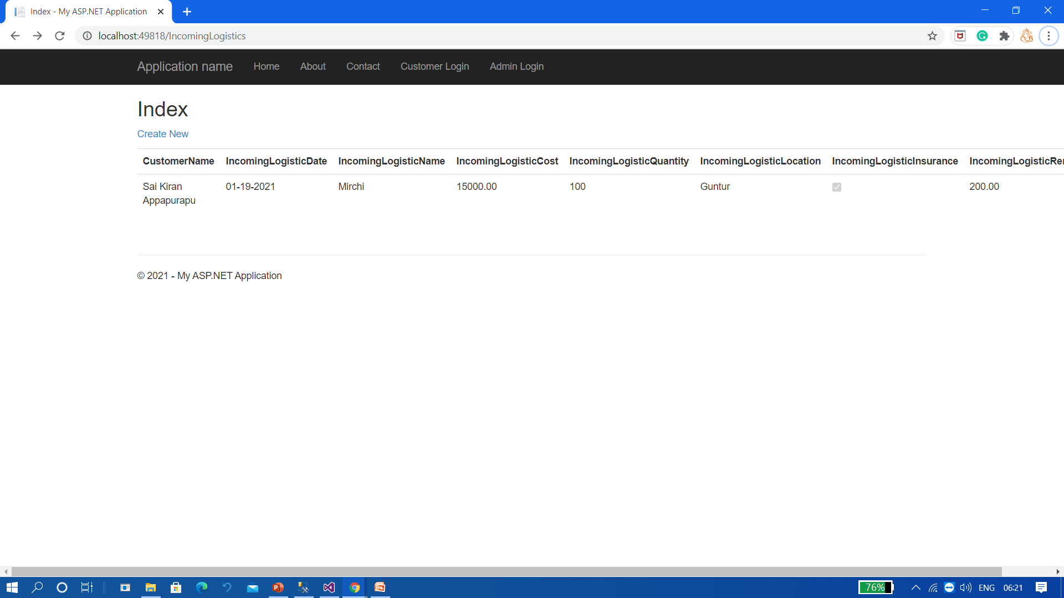
Inward Products Details:

Slide 31
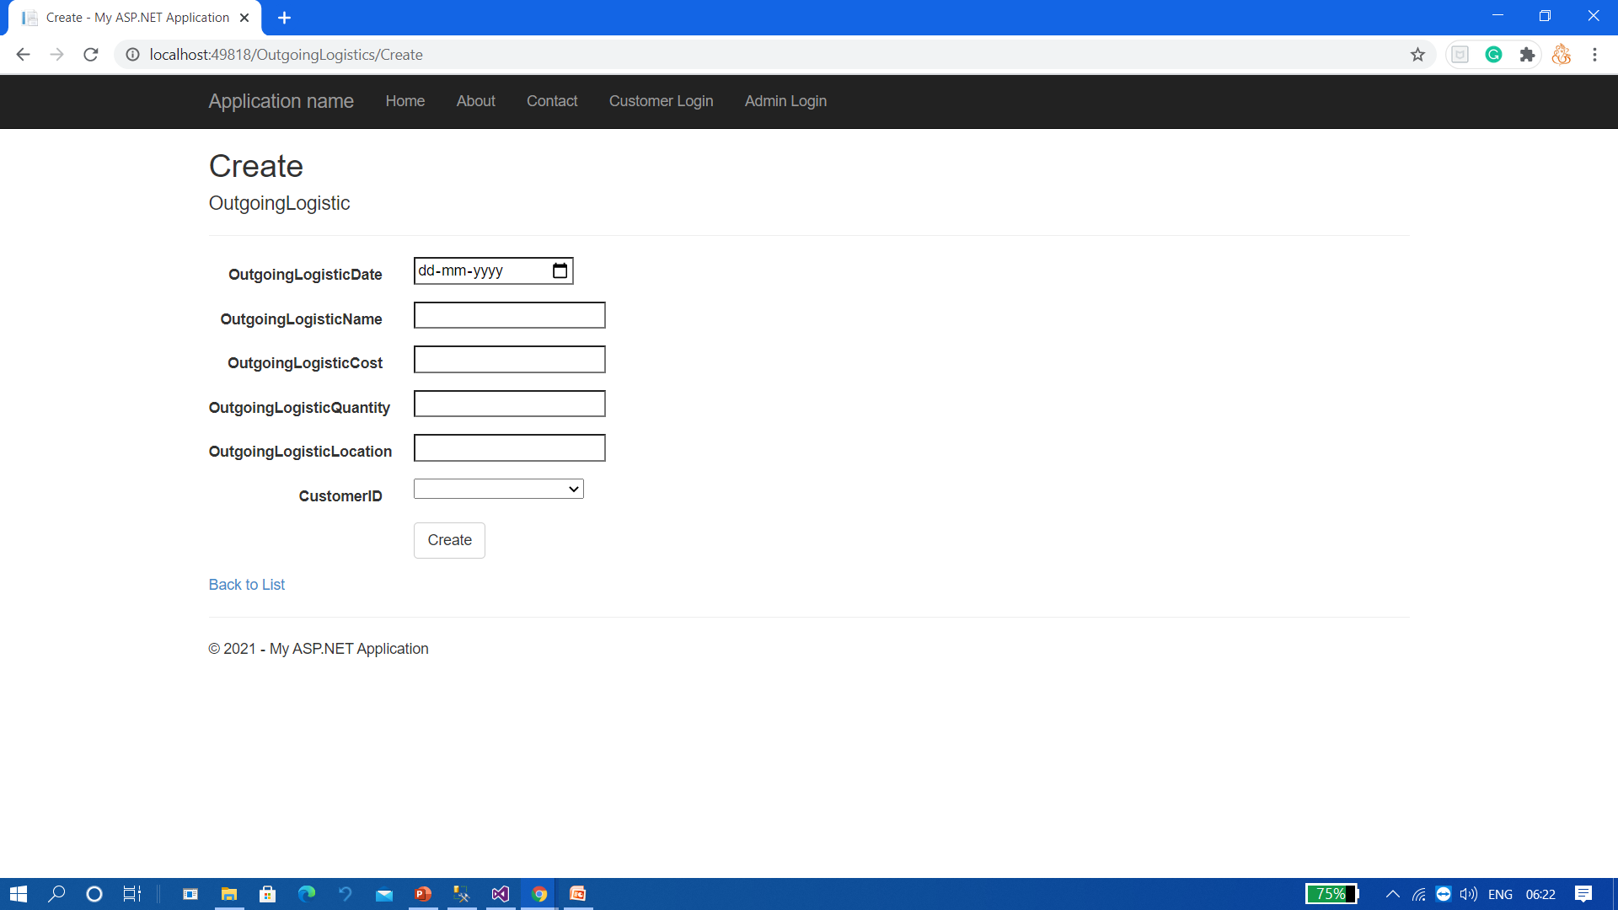
Outward Products Entry Form:

Slide 32
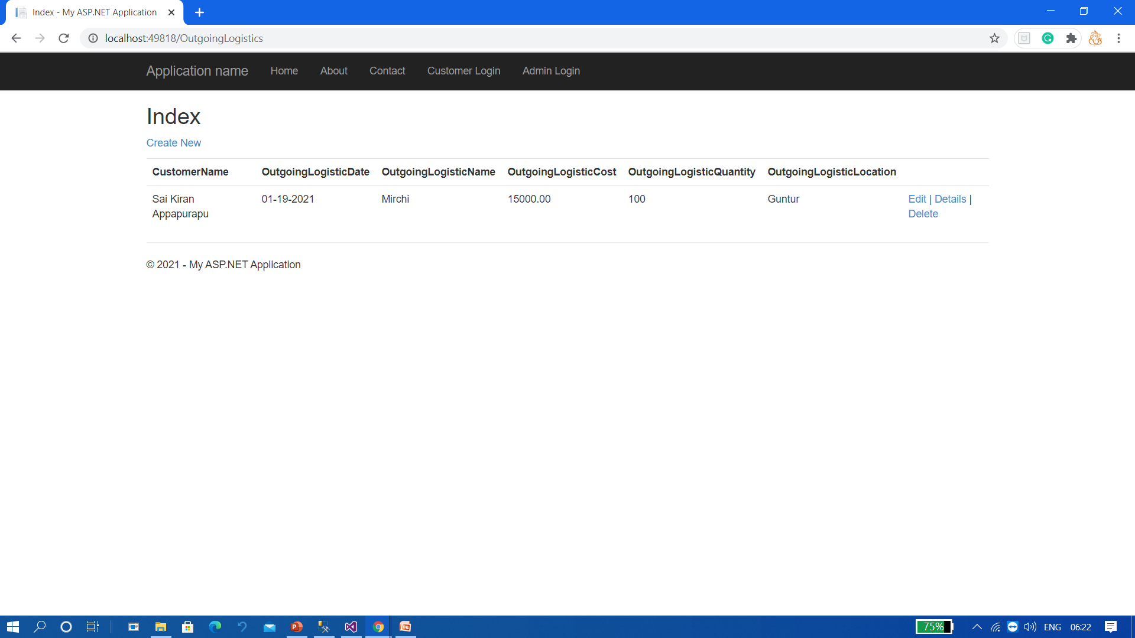
Outward Products Details:

Slide 33
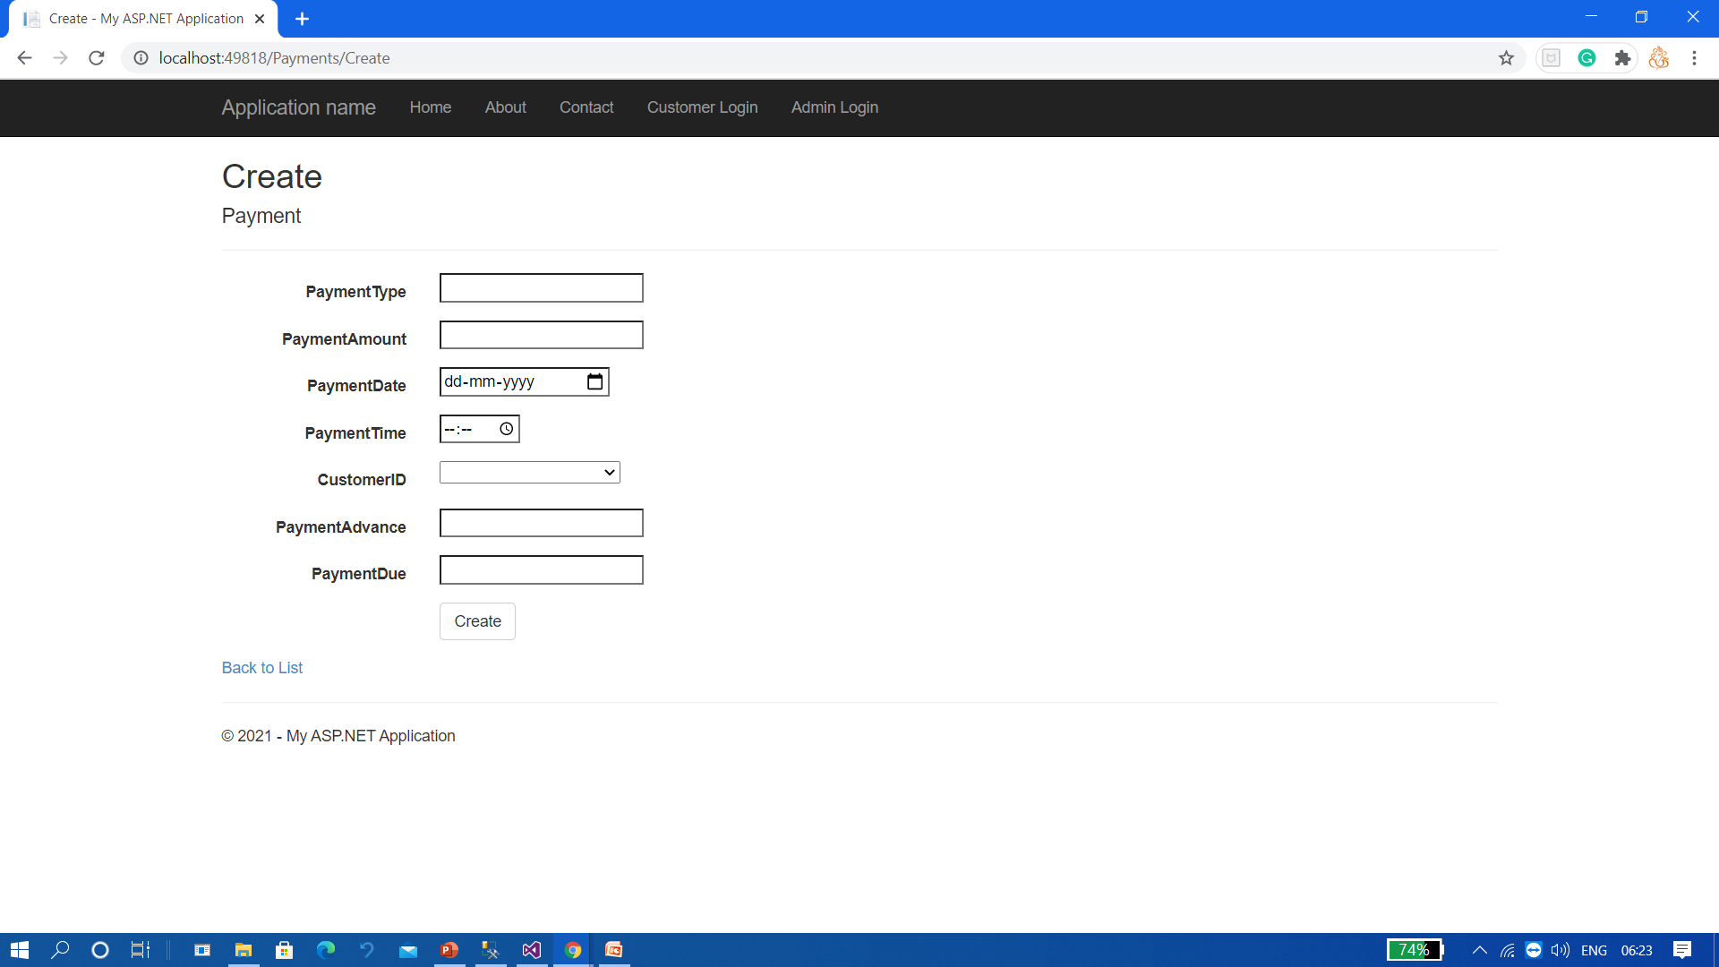
Payment Information Entry Form:

Slide 34

Payment Details:

Slide 35

Customer Loan Information Entry Form:

Slide 36

Customer Loan Details:

Slide 37
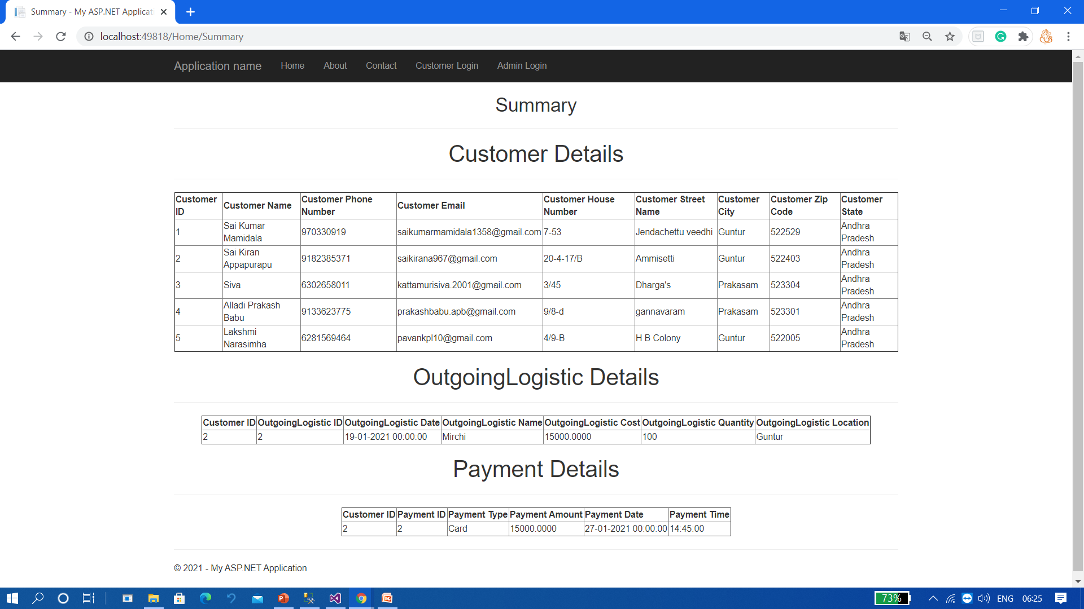
Admin work Summary

Slide 38
ER Diagram

Slide 39
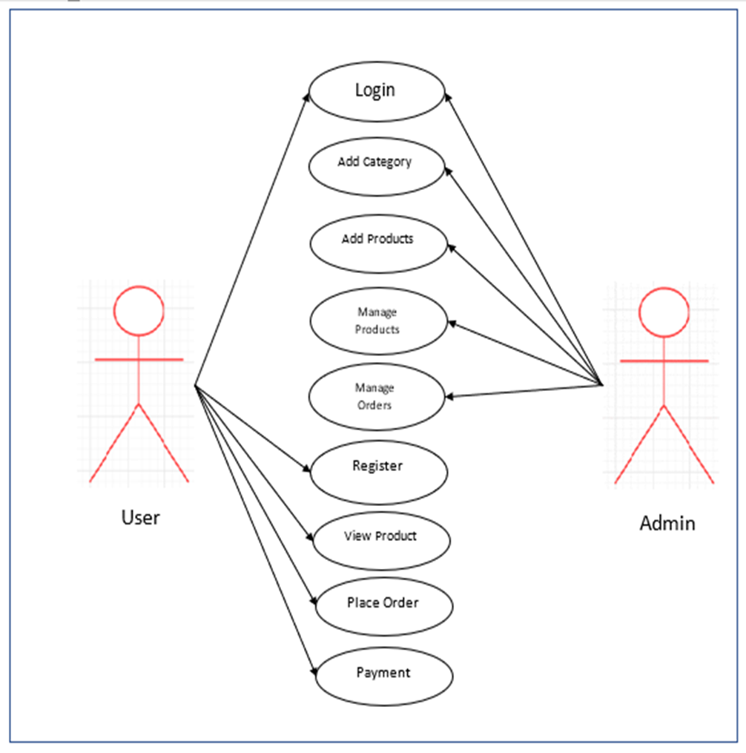
Use Case Diagram

Slide 40
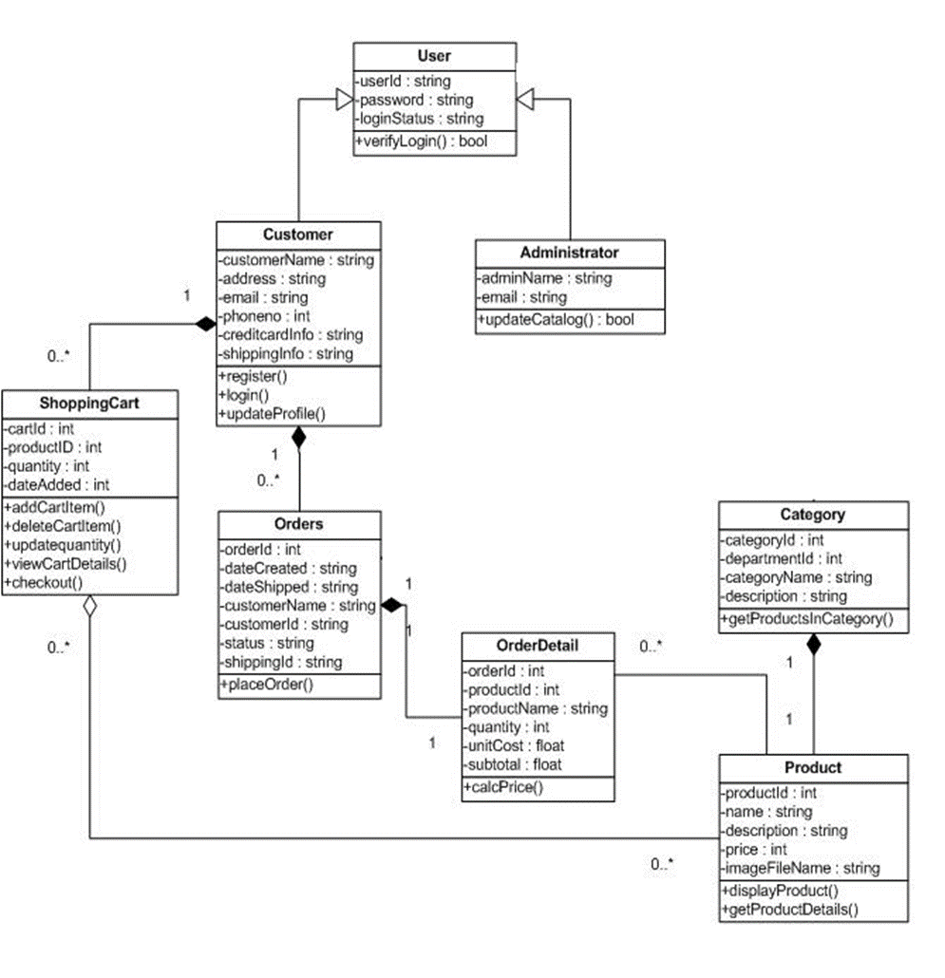
Class Diagram

Slide 41
Testing &Test cases

Slide 42
Input | Expected behaviour | Observed behaviour | Status
Invalid data for Customer Login | Enter Valid Customer ID and password | Invalid Customer ID or password | Success
Invalid Customer ID and valid password | Please enter valid Customer ID | Please enter valid Customer ID | Success
valid Customer ID and invalid password | valid Customer ID and invalid password | Please enter valid password | Success
invalid Customer ID and password | invalid Customer ID and password | Please enter valid password | Success
no Customer ID and password | no Customer ID and password | Please enter Customer ID and password | Success

Slide 43

Testcase 1: Customer login
Scenario 1:
Input : valid Customer name and password
Expected behaviour : Successful login
Actual behaviour: Successful login
Status:Pass

Slide 44
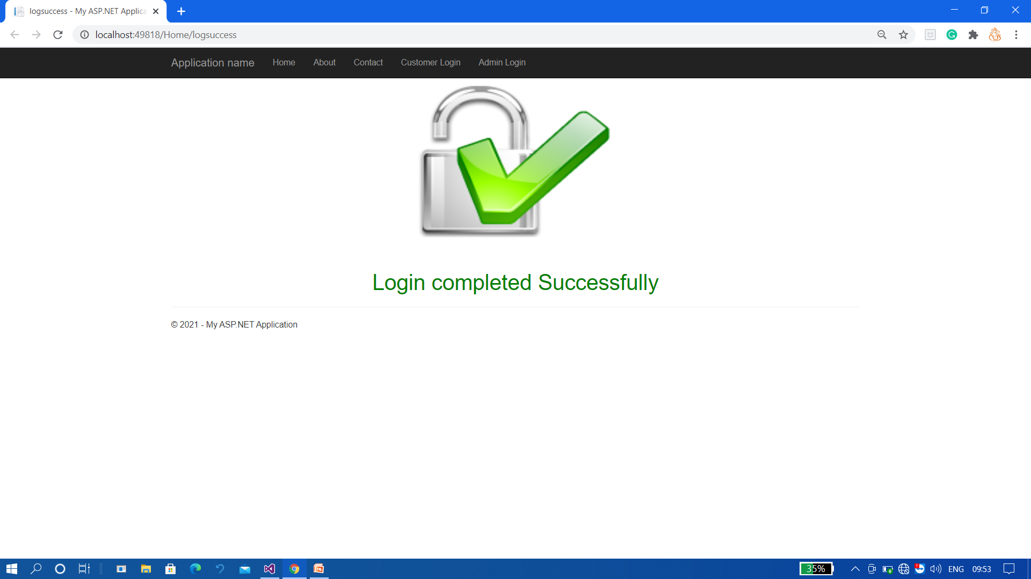
Output:

Slide 45
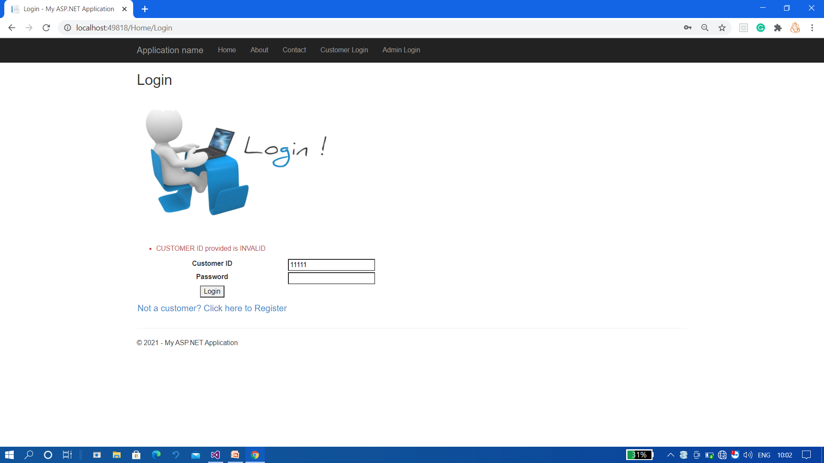
Scenario 2:
Input : Invalid username and valid password
Expected behaviour: Please enter valid username
Actual behaviour: Enter valid username
Status: Pass

Slide 46
Scenario 3 : valid username and invalid password
Input: valid username and invalid password
Expected behaviour : Please enter valid password
Actual behaviour: Enter valid password
Status : Pass
:

Slide 47
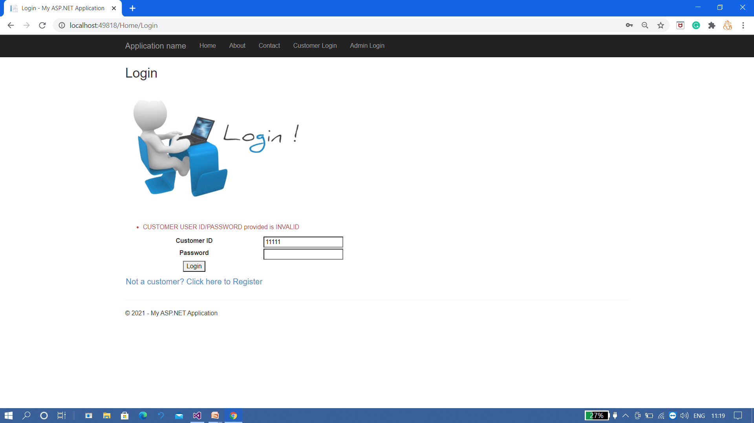
Scenario 4 : invalid username and password
Input : invalid username and password
Expected behaviour : Please enter valid username and password
Actual behaviour: Please enter valid username and password
Status: pass

Slide 48
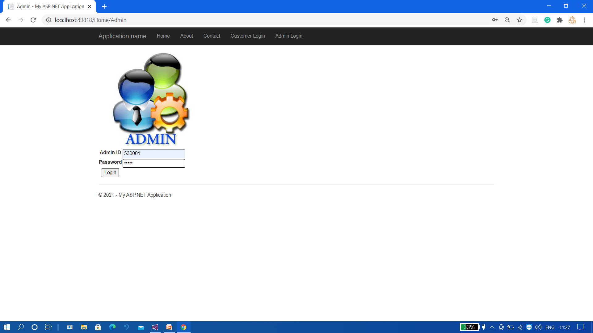
Testcase 2: Admin login
Scenario 1:
Input : valid Admin ID and valid password
Expected behaviour: : Successful login
Actual behaviour: : Successful login
Status: Pass

Slide 49
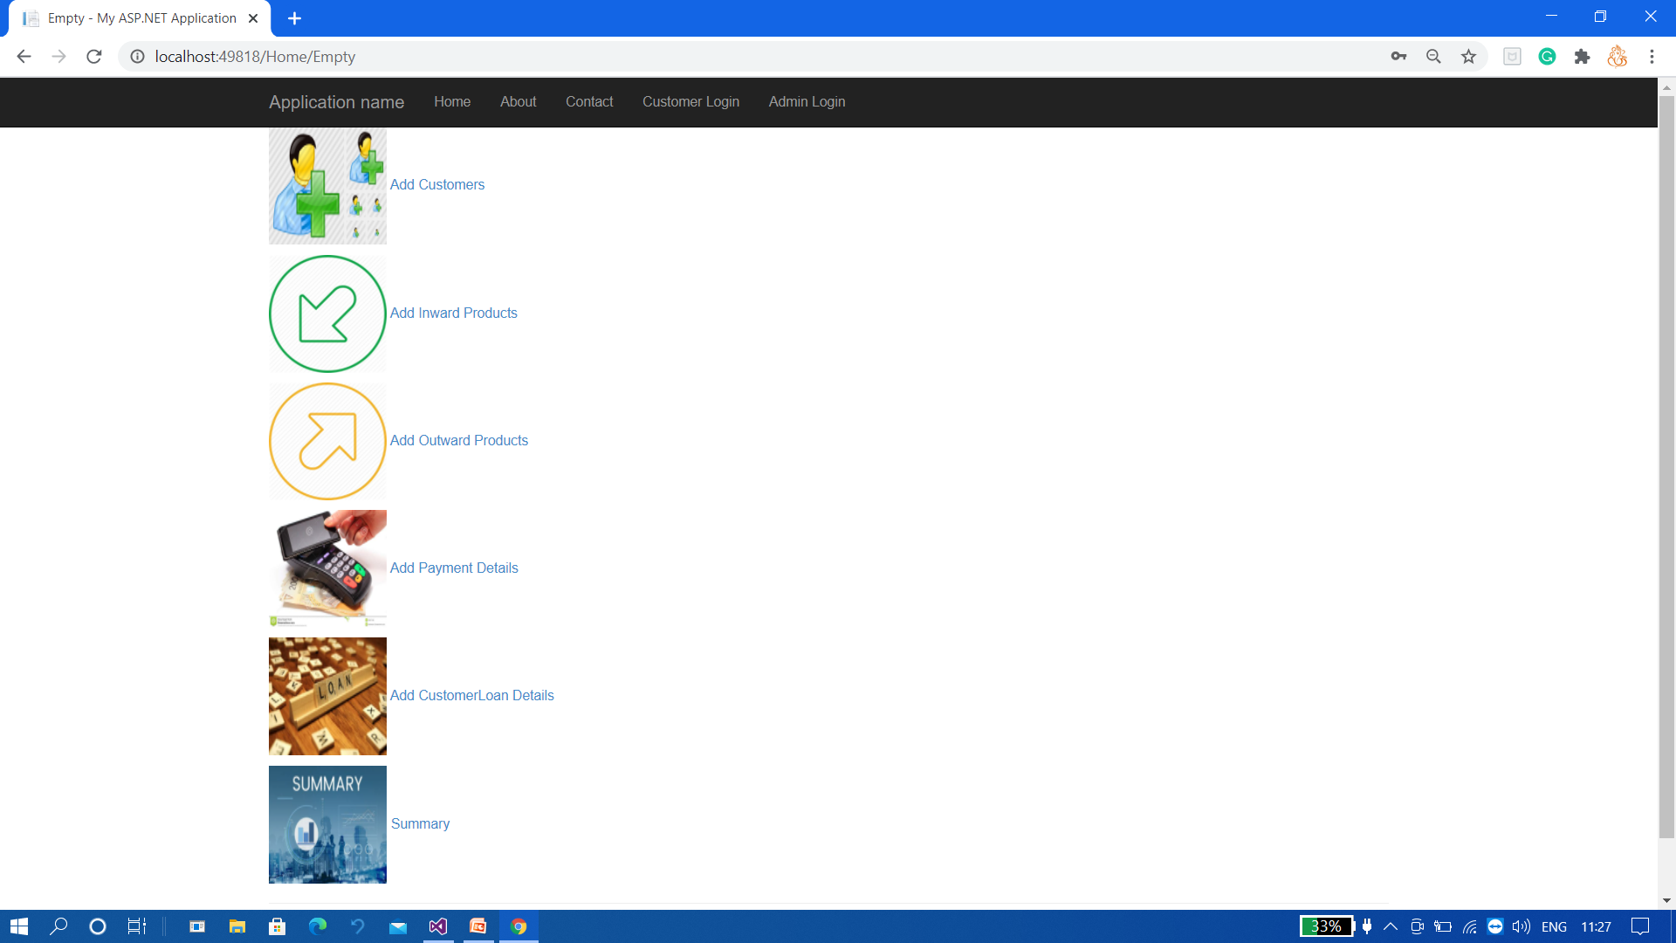
Output:

Slide 50
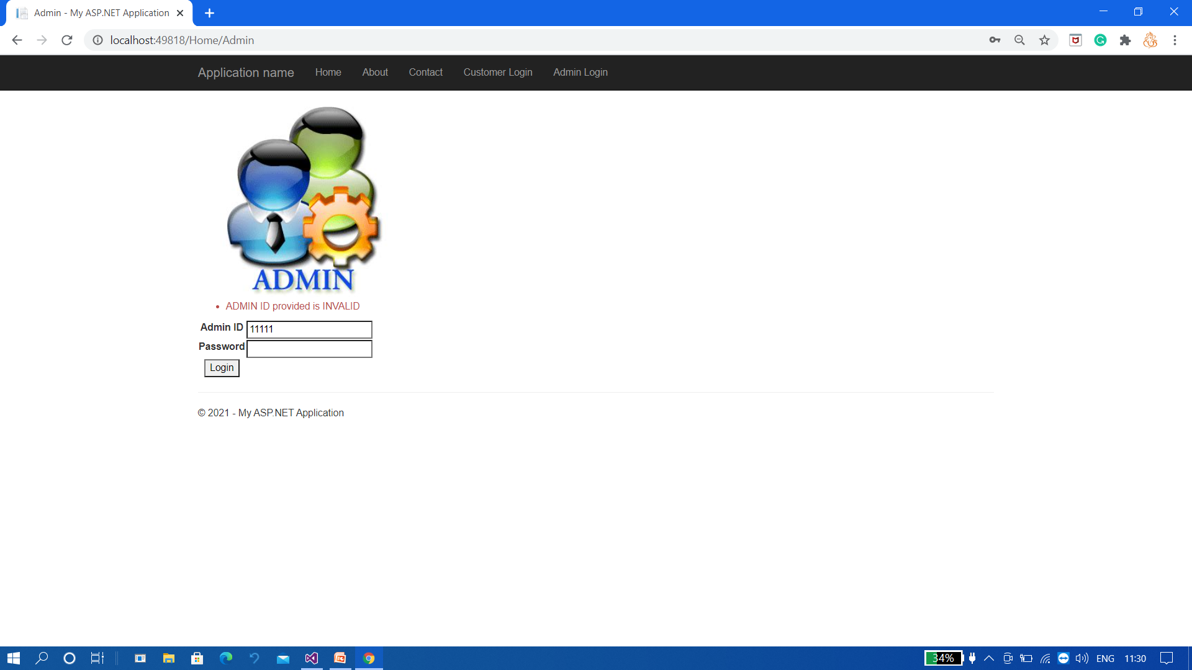
Scenario 2:
Input : Invalid Admin ID and valid password
Expected behaviour: Please enter valid Admin ID
Actual behaviour: Enter valid Admin ID
Status: Pass

Slide 51

Scenario 3 : valid Admin ID and invalid password
Input: valid Admin ID and invalid password
Expected behaviour : Please enter valid password
Actual behaviour: Enter valid password
Status : Pass
:

Slide 52

Scenario 4 : invalid Admin ID and password
Input : invalid Admin ID and password
Expected behaviour : Please enter valid Admin ID and password
Actual behaviour: Please enter valid Admin ID and password
Status: pass

Slide 53
Conclusion:
The Cold Storage Management System is a web based application in which customer can easily can get his profile and invoice and Admin(Manager) can maintain all details of products ,customer and payments.
This application can reduce paper work

Slide 54


